Slide 1

Lithographic and Non-Lithographic Processes
Techniques for Nanostructure Fabrication

Slide 2

Introduction
Lithographic and Non-Lithographic Processes are techniques for nanostructure fabrication.
Lithographic Process: Uses chemical/mask-based patterning.
Non-Lithographic Process: Based on self-organization and deposition techniques.
Used in semiconductor and nanomaterial industries.

Slide 3
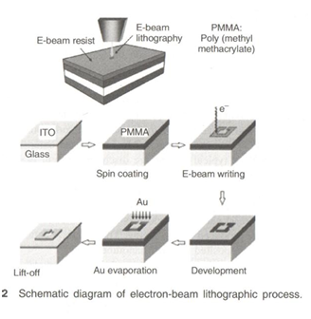
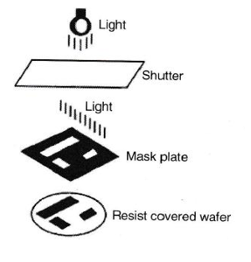
Lithographic Processes
1. Photolithography
Uses light and a photomask to transfer patterns onto a substrate.
Deep Ultraviolet (DUV) Lithography: Uses 248 nm & 193 nm light for small features (down to 50 nm).
Used in: Fabrication of silicon-based electronic & photonic devices.
2. Electron Beam Lithography (E-Beam Lithography)
Uses a beam of electrons to create patterns at the nanoscale.
Advantages: Can overcome the diffraction limit of light and create sub-20 nm features.
Limitations: Very slow, mainly used in research and mask-making.

Slide 4
Non-Lithographic Process
Definition:
Fabrication technique based on natural self-organization rather than masks.
Types:
Vacuum-Based Deposition Process
Solution-Based Deposition Process
Advantages:
Cost-effective, flexible for nanomaterial synthesis.
Limitations:
Not yet fully integrated into industrial semiconductor fabrication.

Slide 5

Vacuum-Based Deposition Processes
Deposition occurs in high vacuum (10⁻⁸ to 10⁻¹¹ mbar).
Advantages:
Highly pure & clean process with minimal contamination.
Suitable for advanced device fabrication.
Disadvantages:
Requires expensive and complex equipment (vacuum pumps, gauges, leak-proof accessories).
Examples:
Plasma Arc Deposition
Evaporation
Sputtering
Chemical Vapor Deposition (CVD)
Molecular Beam Epitaxy (MBE)

Slide 6
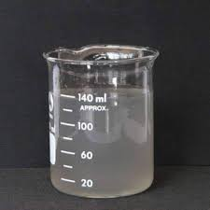
Solution-Based Deposition Processes
Deposition occurs through chemical reactions in a liquid medium.
Advantages:
Simple, cost-effective, and can synthesize a wide range of materials.
Disadvantages:
Not as clean as vacuum-based processes.
Impurities may affect material properties.
Not fully compatible with solid-state electronics.
Examples:
Sol-gel Dip Coating
Spin Coating
Spray Pyrolysis
Electrodeposition
Chemical Bath Deposition

Slide 7

Thank You

